Slide 1
Design Examples
Created By: Jeffrey A. Shaffer Vice President, Unifund Adjunct Faculty, University of Cincinnati (513) 615-0001 | JeffreyShaffer@gmail.com @HighVizAbility
Notes:
Title Slide

Slide 2
Design Examples

Slide 3
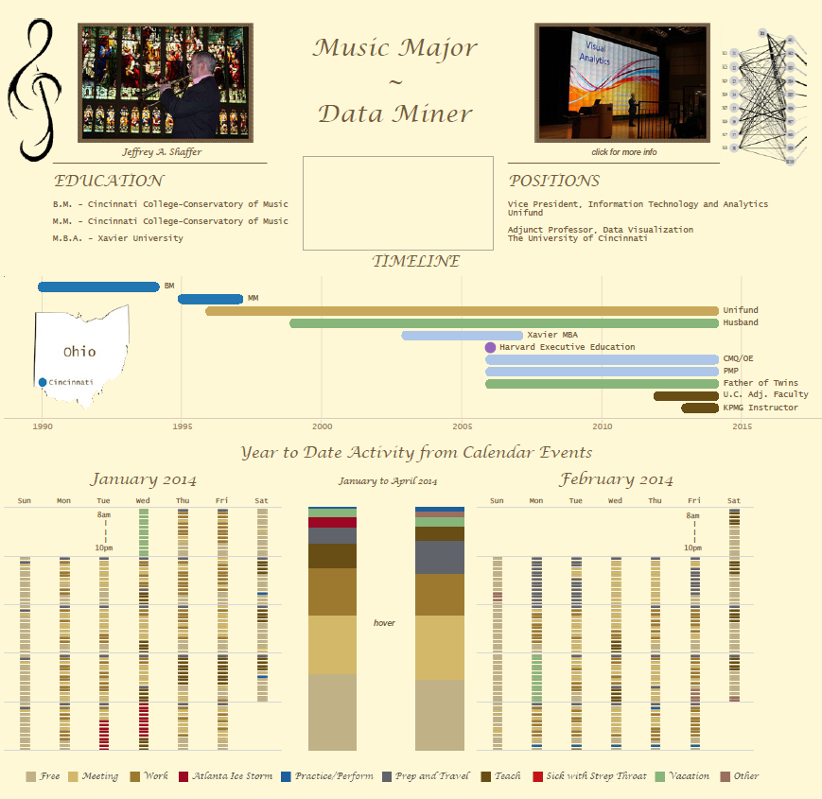
Created by Jeffrey A. Shaffer
Source: Tableau Public
Notes:
This visualization was done by Jeff Shaffer. Jeff is the Adjunct Professor of Data Visualization at the University of Cincinnati. This viz was created for the Tableau Iron Viz competition and the topic was Quantified Self. The viz starts off as a resume, showing his Education and Positions along with a timeline. Then he tracked his outlook calendar appointments and categorized them into a number of categories.

Slide 4
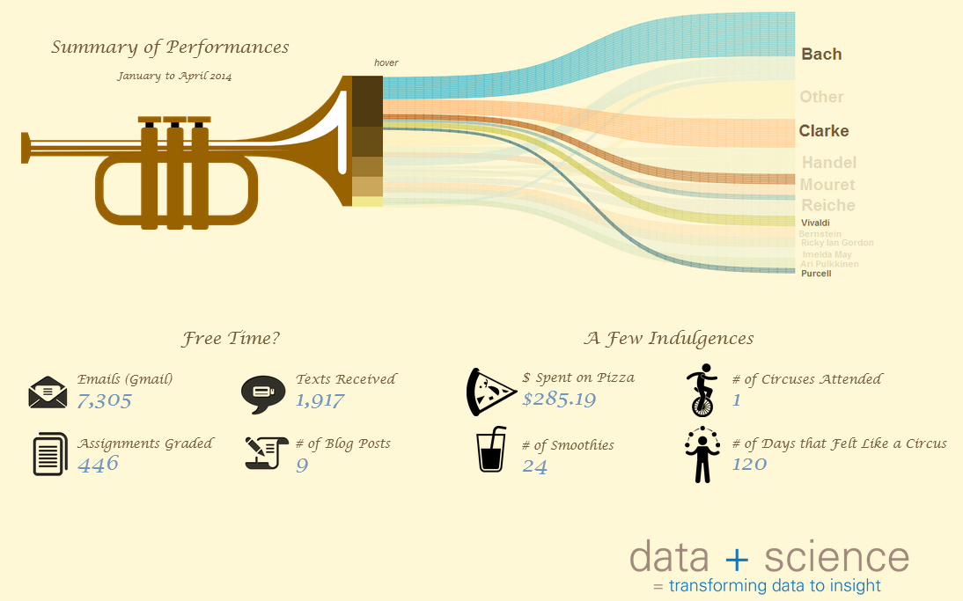
Created by Jeffrey A. Shaffer | Source: Tableau Public
Notes:
The bottom half of the visualization shows various music concerts he performed on, using a Sankey from the trumpet bell to connect to the composers of those pieces. The last section shows icons and big numbers for various data points he tracked, for example the number of emails, assignments he graded and text messages received.
He took his inspiration for this viz from another visualization designer, Giorgia Lupi.

Slide 5
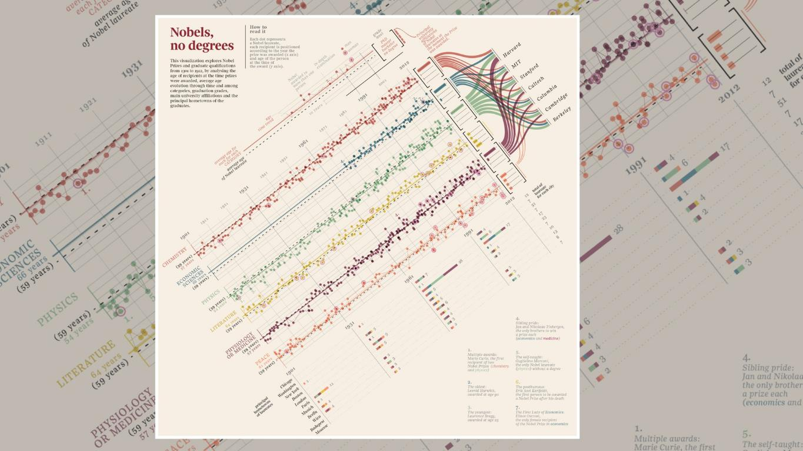
Notes:
The visualization that inspired him was Nobel, No Degrees. Giorgia visualizes the winners of the Nobel Prize in the various categories. This viz won the top prize at the Information is Beautiful Award and Jeff asked Giorgia to say a few words about her visualization.

Slide 6

Notes:
[VIDEO – Words from Giorgia Lupi]
[Giorgia walks through her visualization of Nobel, No Degrees. The following slides are part of this video.]

Slide 7
Notes:
Giorgia’s visualization of Nobel, No Degrees

Slide 8
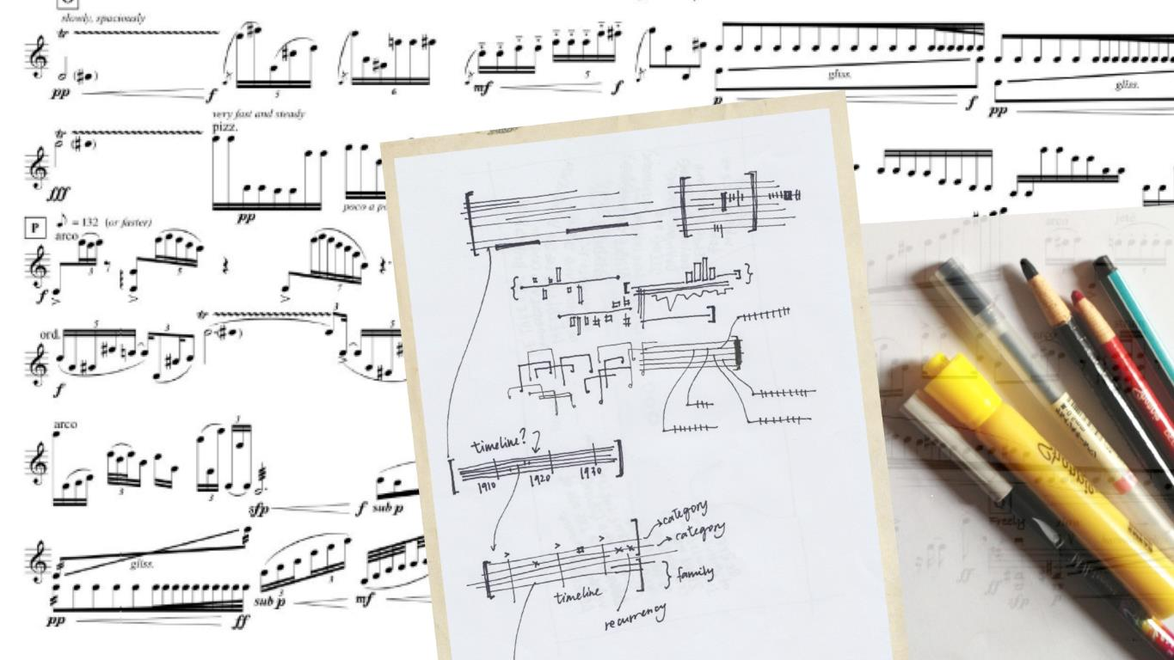
Notes:
Giorgia plays piano and is inspired by various forms of musical notation. She often sketches based on these inspirations.

Slide 9
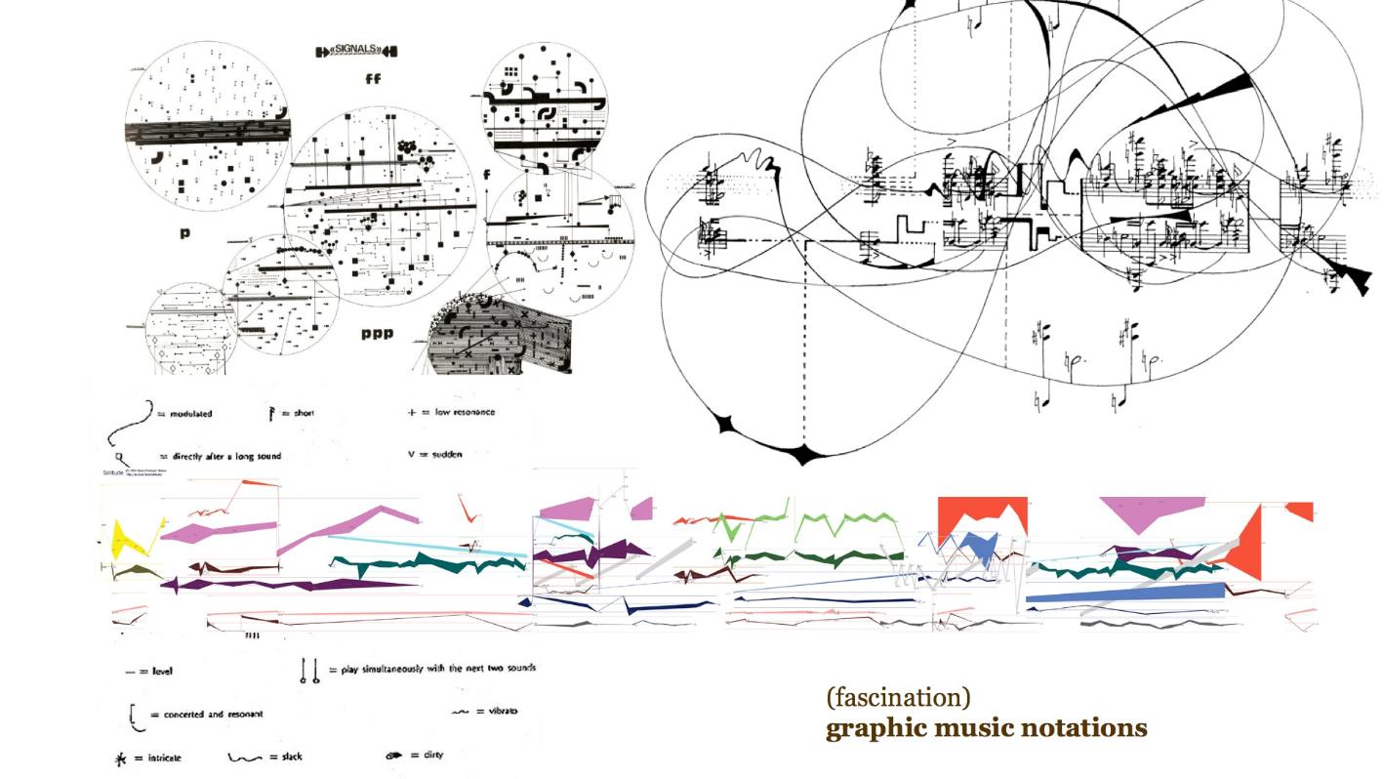
Notes:
Some of the musical forms don’t look like traditional music, but they are.

Slide 10
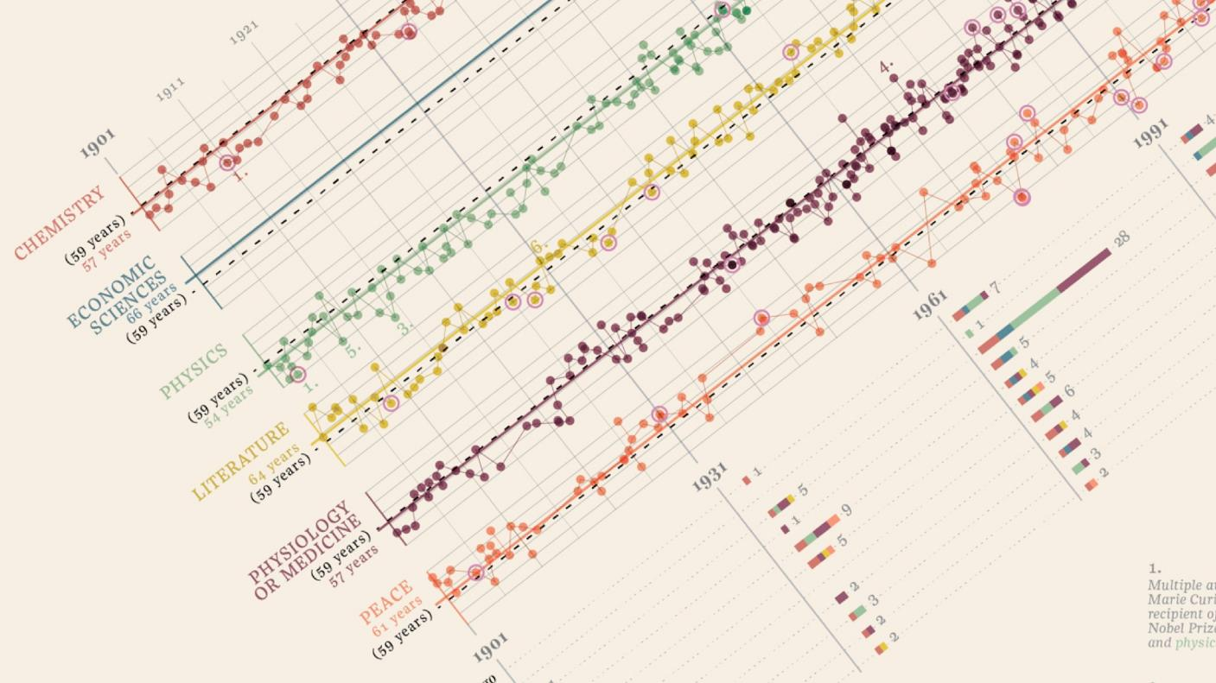
Notes:
The visualizations shows the Nobel Prize by category. The dots represent the ages of the winners. The color lines are the average age by the category. The dotted line is the overall average age.
Notice the use of colors, earthtones that work very well with the background color.

Slide 11
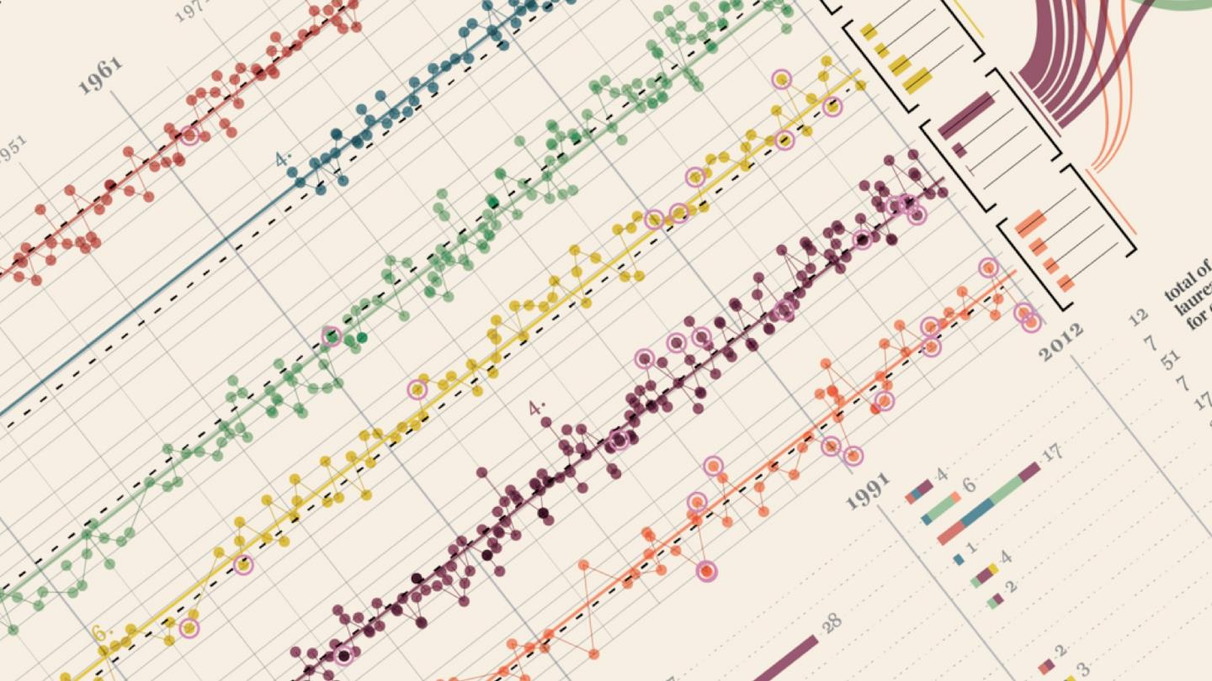
Notes:
Female winners have a pink circle around the dot.

Slide 12
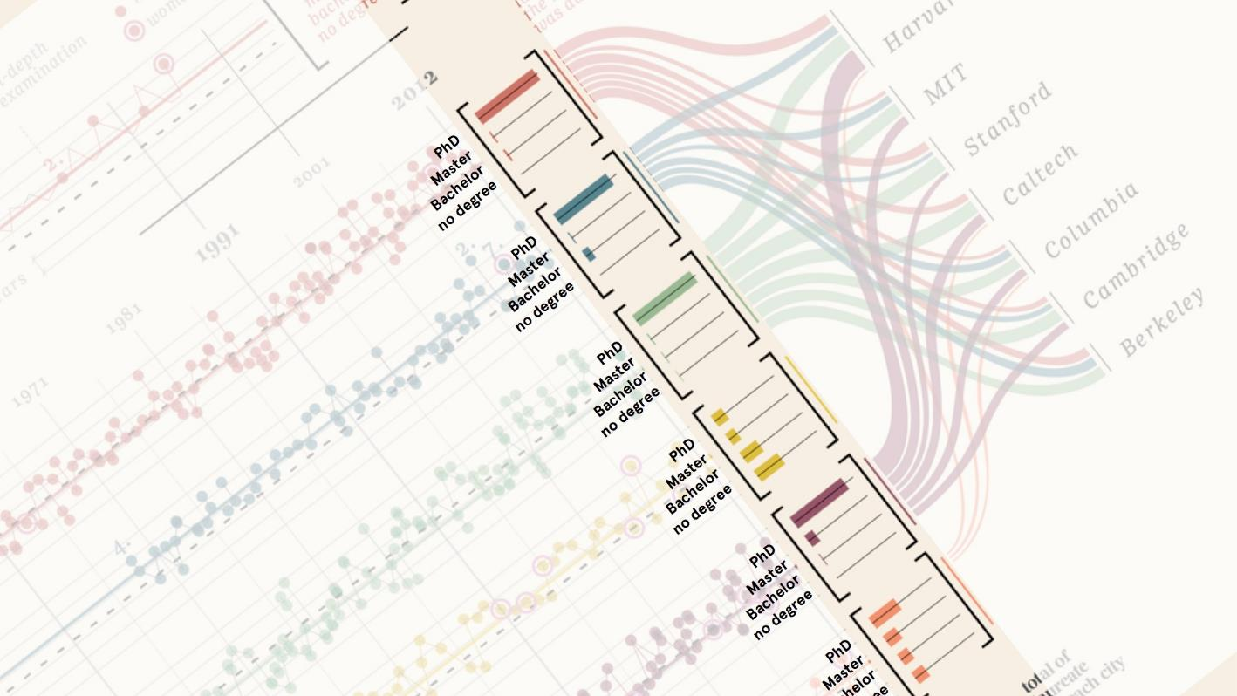
Notes:
The bar chart on the right side shows the degree level of the winners. We can see that Chemistry, Economics and Physics have PhD degrees, while Literature has a distribution of degrees.

Slide 13
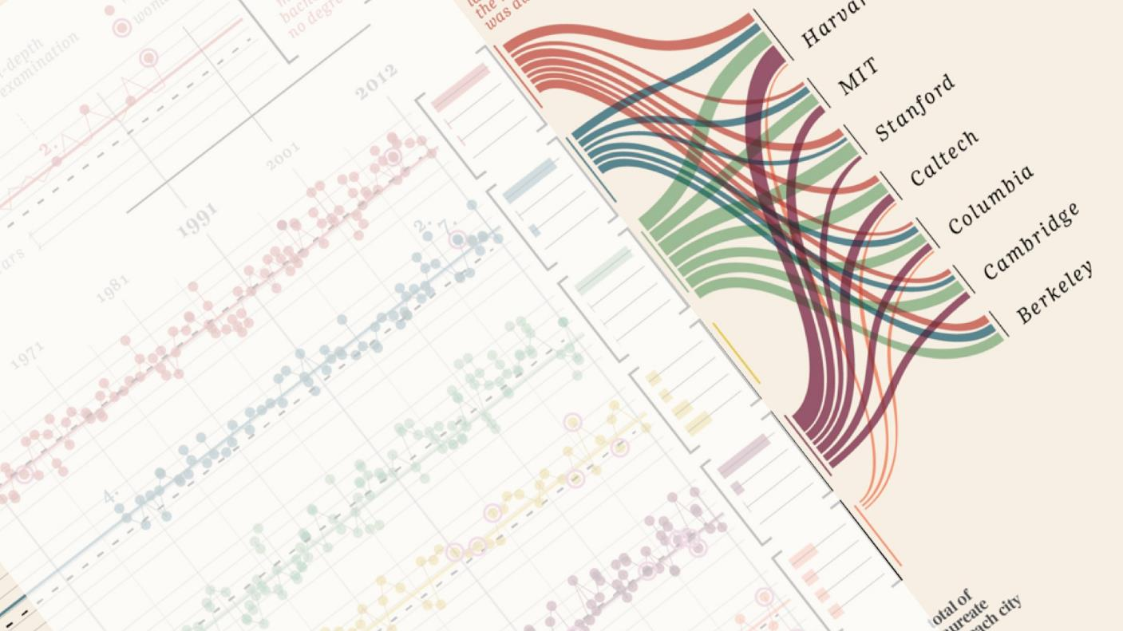
Notes:
The Sankey shows the distribution of those Degrees to the Major Universities.

Slide 14
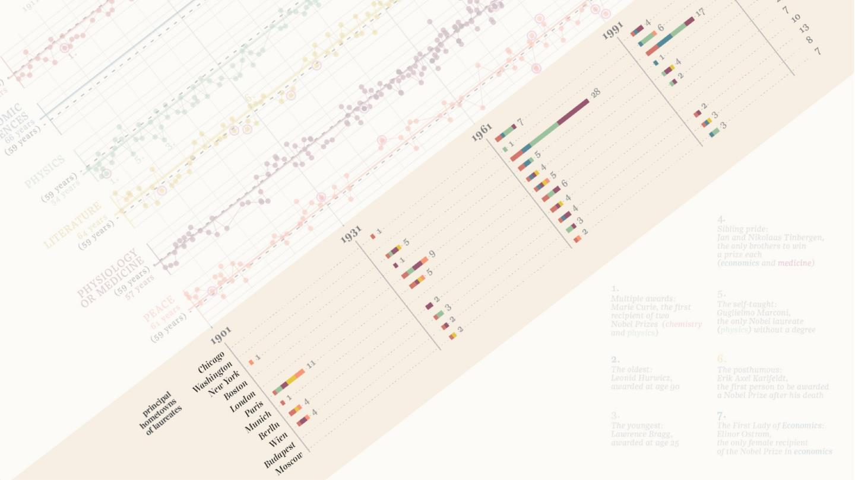
Notes:
The stacked bar chart on the bottom shows the major cities that the winners came from. We see Paris in the early 20th century moving to New York by the 1960’s.

Slide 15
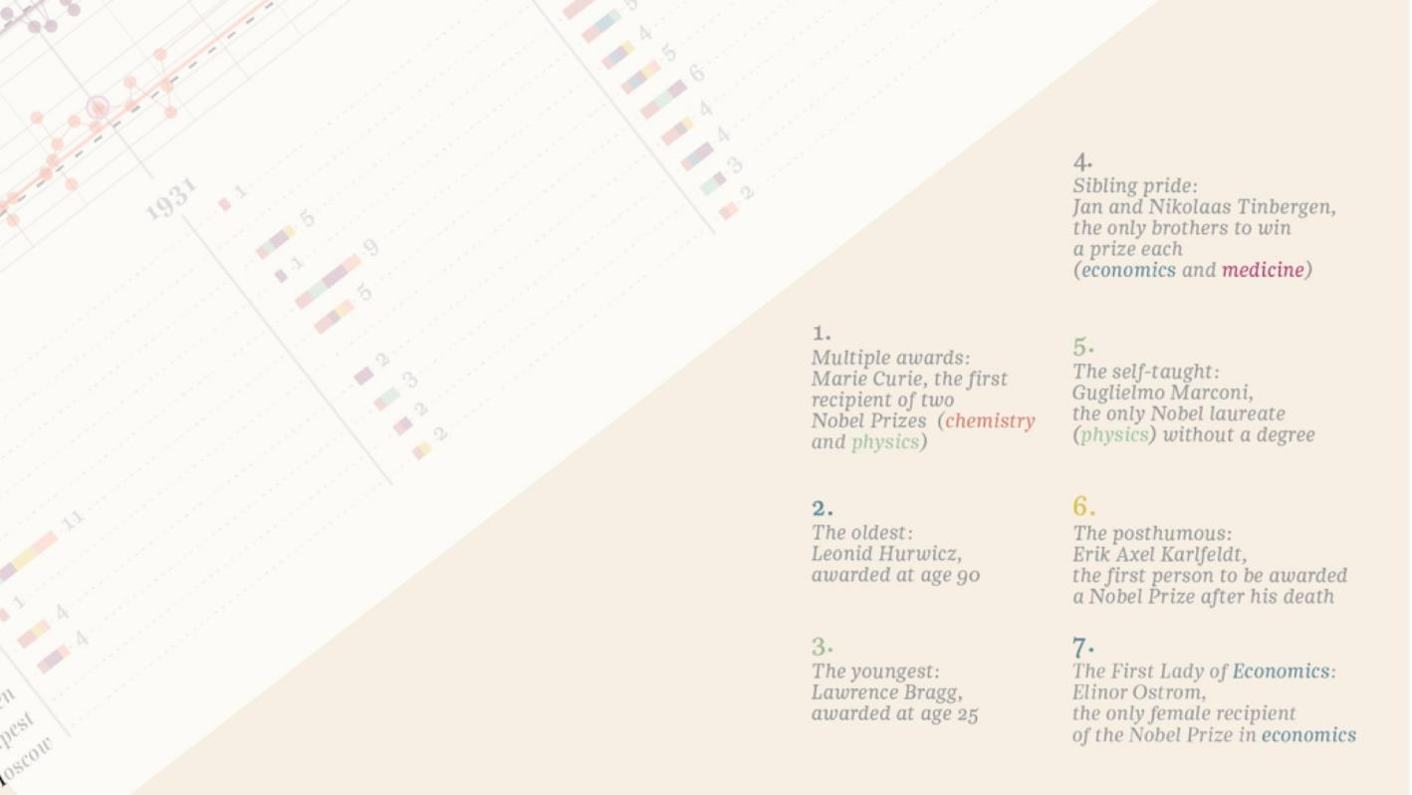
Notes:
There is a great annotation layer offering interesting notes about the winners. The oldest and youngest winners and two siblings. They are color coded to match the Nobel cetagory.

Slide 16
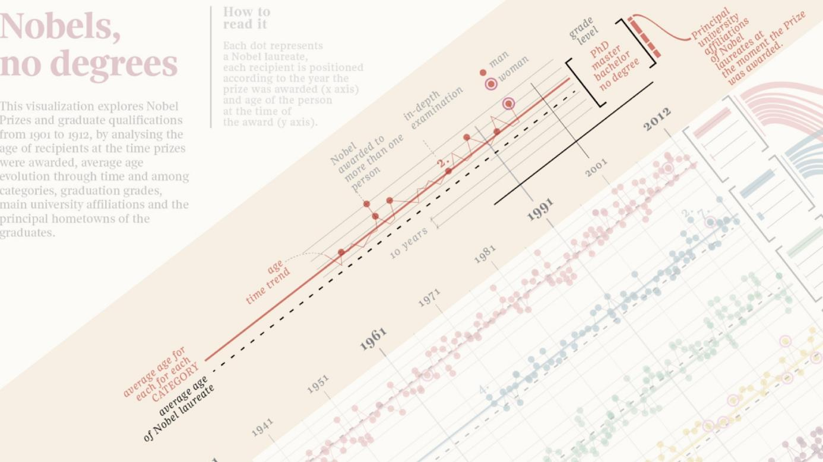
Notes:
Across the top there is a very detailed “how to read” section. It outlines all of the little details throughout the visualization.

Slide 17
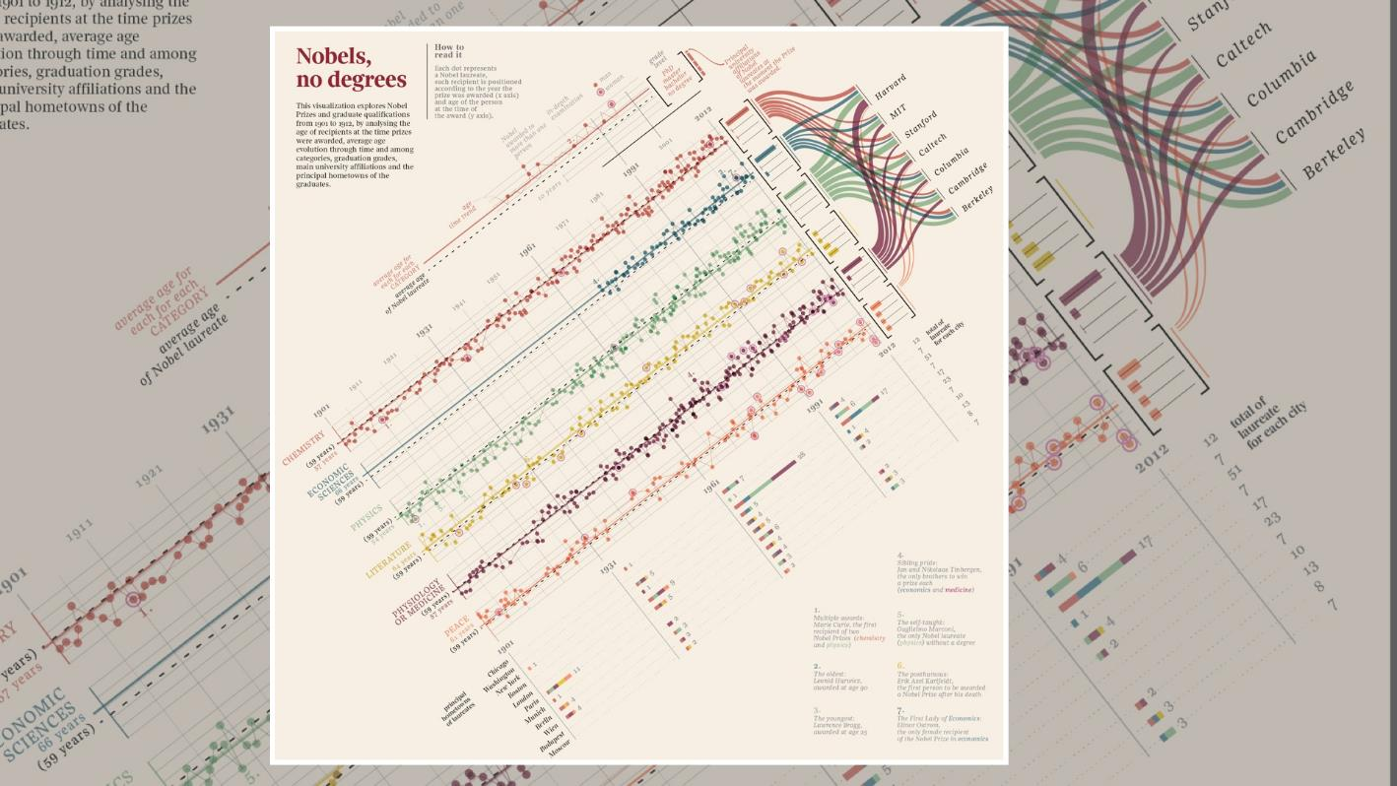
Notes:
You can see why this visualization won the Gold Medal Award from Information is Beautiful.

Slide 18
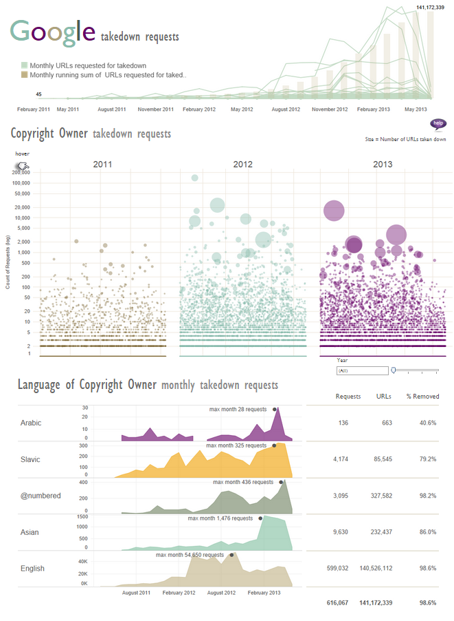

Notes:
This visualization is done by Kelly Martin. This visualization shows the Google takedown requests. Notice the use of color and careful decisions on the chart types, using a dot plot with jitter to show the magnitude and scale of the takedown requests and the area charts on the bottom showing requests over time.

Slide 19
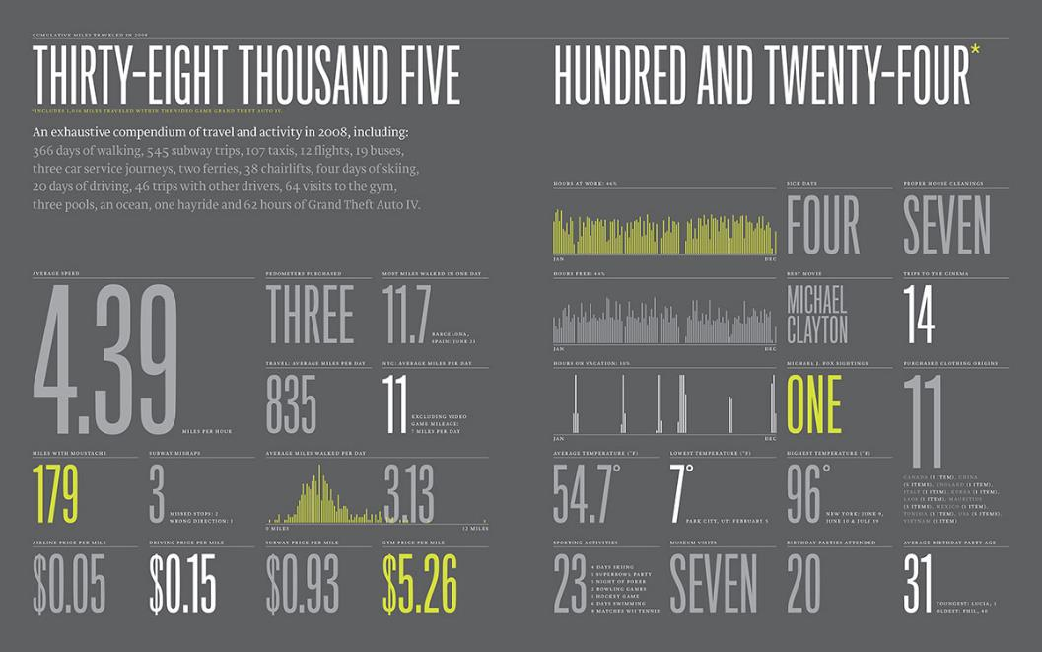
2008 Feltron Report
http://feltron.com
Notes:
For ten years Nicolas Felton tracked different aspects of his life in a grand quantified self project. For 10 years he created an “annual report” about himself which he published and sold as The Feltron Report. This report is from 2008 showing the distance he travelled that year through various methods. He kept track of miles walked, subway rides, taxis, flights, buses, car services, ferries and even the distance he traveled playing Grand Theft Auto IV. Notice the use of color, with just 3 simple colors and the use of font contrast, with large, medium and small fonts.

Slide 20
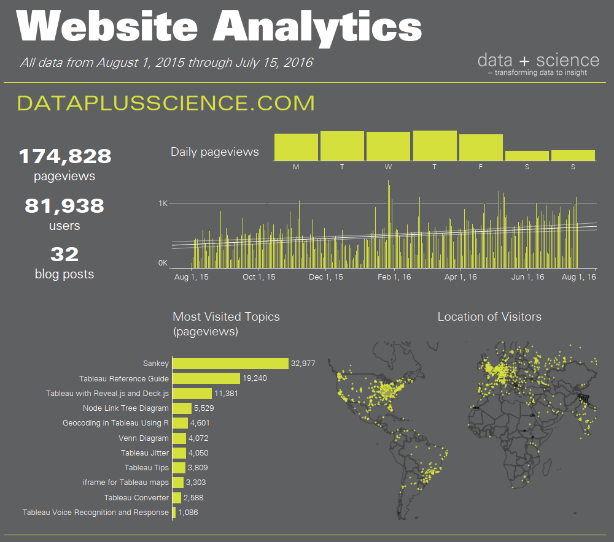
Source: The Big Book of Dashboards (BigBookofDashboards.com)
Notes:
The 2008 Feltron Report inspirited thisWeb Analytics Dashboard from The Big Book of Dashboards. A very similar use of color and font contrast.

Slide 21
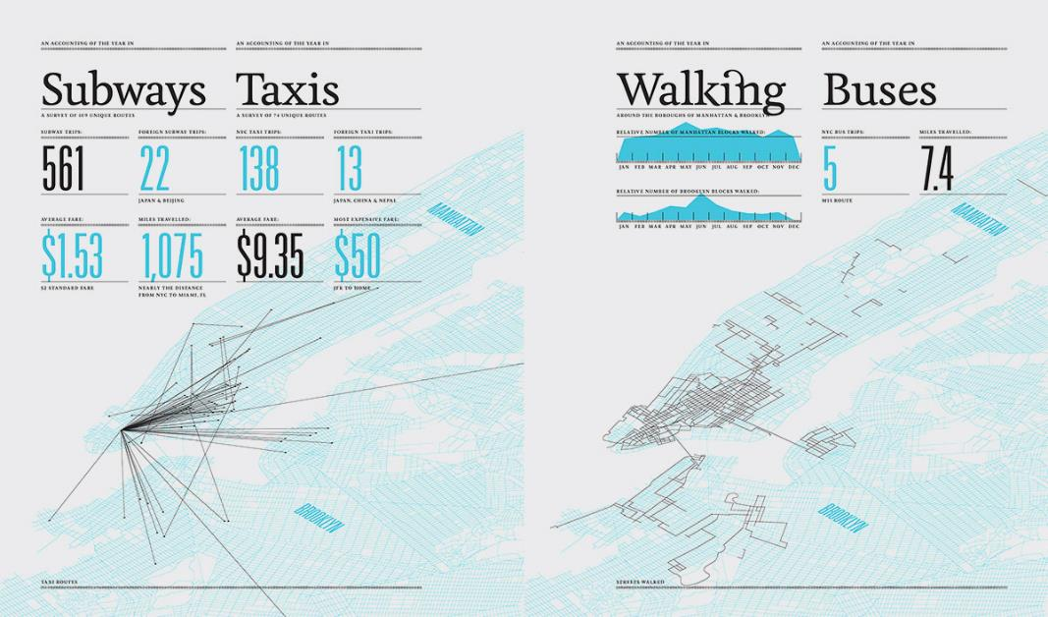
2007 Feltron Report
http://feltron.com
Notes:
This is from the 2007 Feltron Report, where Nicolas Felton plots the paths he traveled on a map. Again, a simple use of color and font contrast.

Slide 22
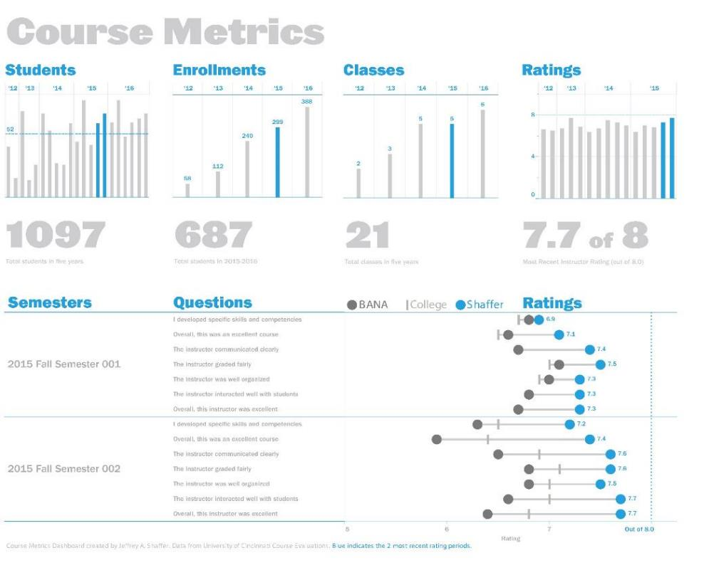
Source: The Big Book of Dashboards (BigBookofDashboards.com)
Notes:
Compare that to the Course Metrics Dashboard from The Big Book of Dashboards. The font was specifically chosen to give weight to the dashboard title and the big numbers. Color is used purposefully, highlighting the current rating period for the selected professor.

Slide 23
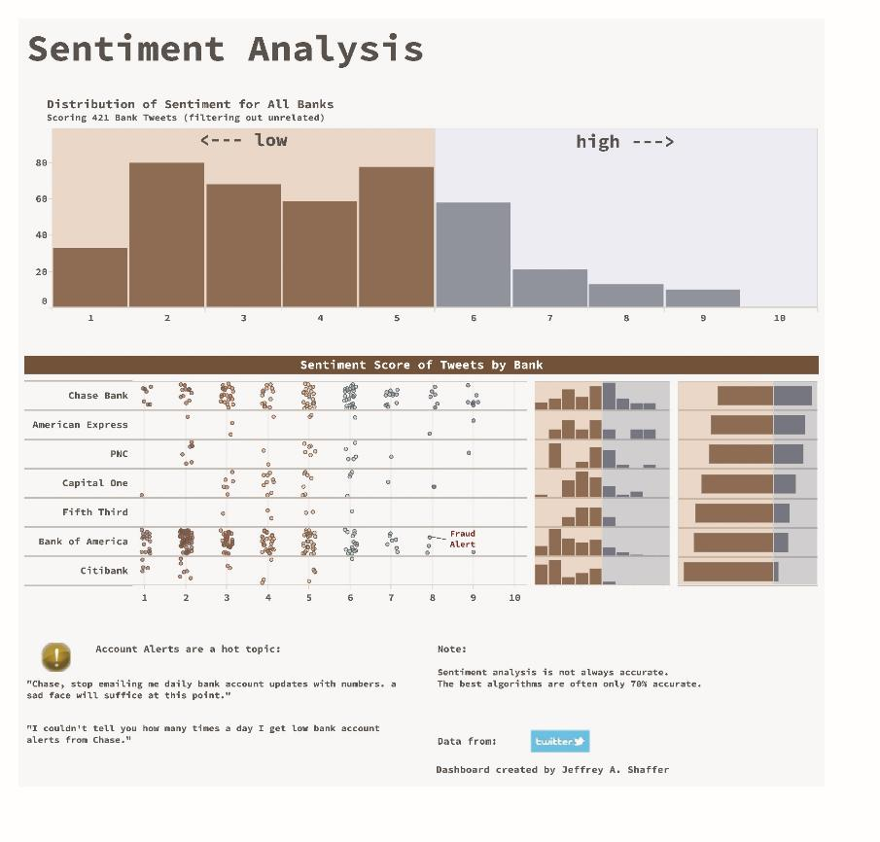
Source: The Big Book of Dashboards (BigBookofDashboards.com)
Notes:
Let’s look at some other examples from The Big Book of Dashboards. This Sentiment Analysis dashboard shows Twitter sentiment for some of the big banks. The sentiment is shown on a scale of 1 to 10 for Chase Bank, American Express, PNC, Capital One, Fifth Third Bank, Bank of America and Citibank. We can see that the sentiment is mostly negative, but some banks more than others. Two colors are used to show negative and positive sentiment. The histogram at the top shows the distribution of the sentiment rating scale. The dot plot shows each individual rating that offers a tooltip on hover to show the individual tweet. There is a histogram and diverging bar chart for each bank to show the distribution of each bank for comparison.

Slide 24
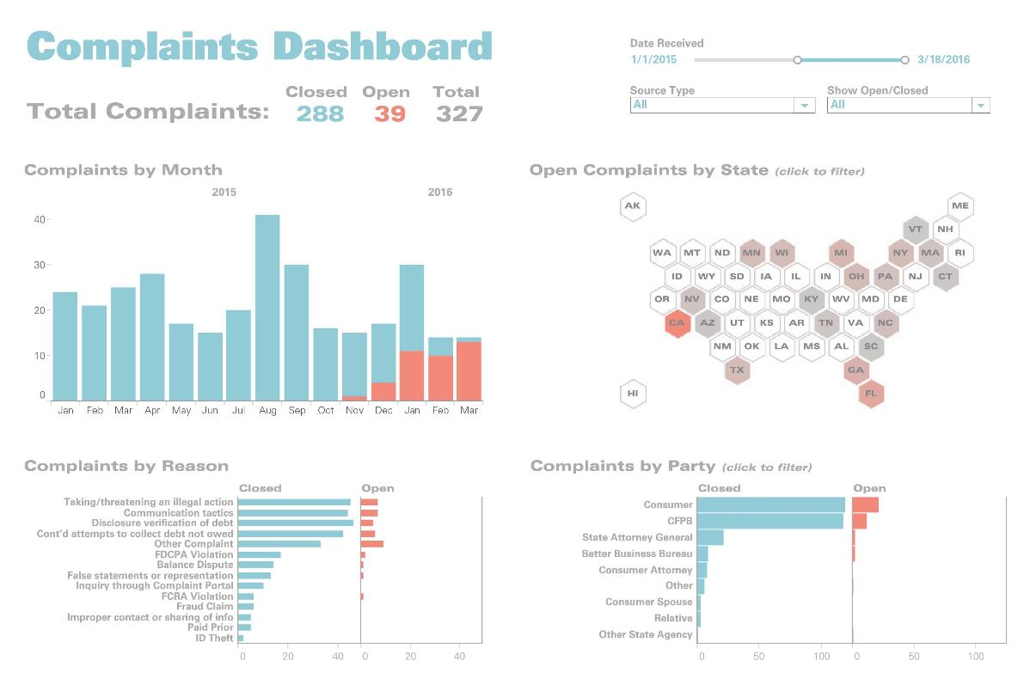
Source: The Big Book of Dashboards (BigBookofDashboards.com)
Notes:
The Complaints Dashboard featured in The Big Book of Dashboards shows open and closed complaints over time. Closed complaints are blue and open complaints are orange. Notice on the stacked bar chart that open complaints are on the bottom, which allows for a very precise comparison from month to month. The hex map of the US shows the current open complaints by State and acts as a simple filter for the rest of the dashboard. The bar charts at the bottom separate open and closed complaints providing more detail of the reason for the complaint and the party filing the complaint.

Slide 25
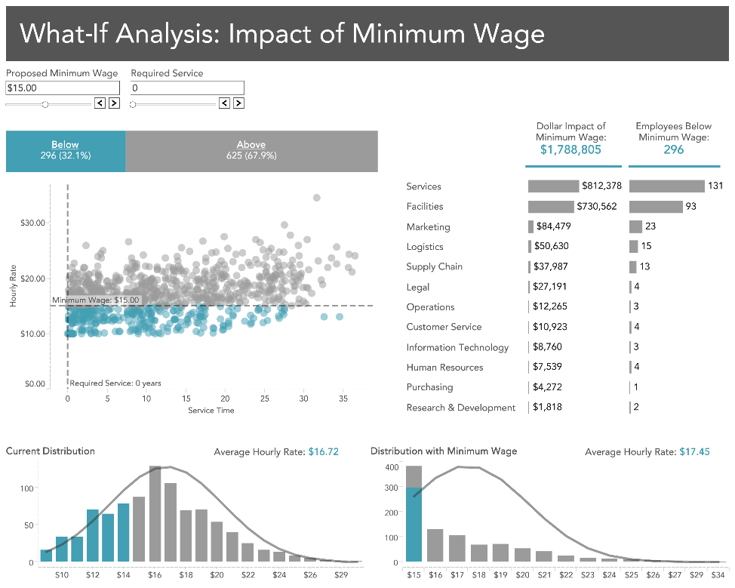
Source: The Big Book of Dashboards (BigBookofDashboards.com)
Notes:
The What-If dashboard from The Big Book of Dashboards has a very similar design. Notice the use of color again. Blue is used for minimum wage and and gray for above minimum wage. Color is used consistently throughout the dashboard.

Slide 26
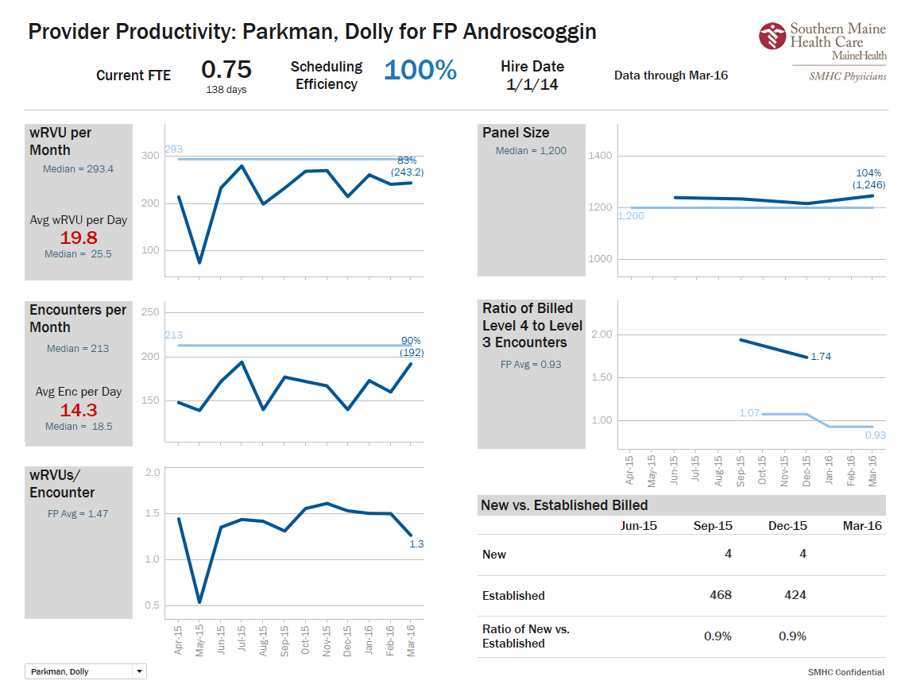
Source: The Big Book of Dashboards (BigBookofDashboards.com)
Notes:
This Productivity Dashboard was created by Jonathan Drummey. It shows various metric over time using a line chart. It’s designed to a grid, has a very simple use of color and good font contrast.

Slide 27
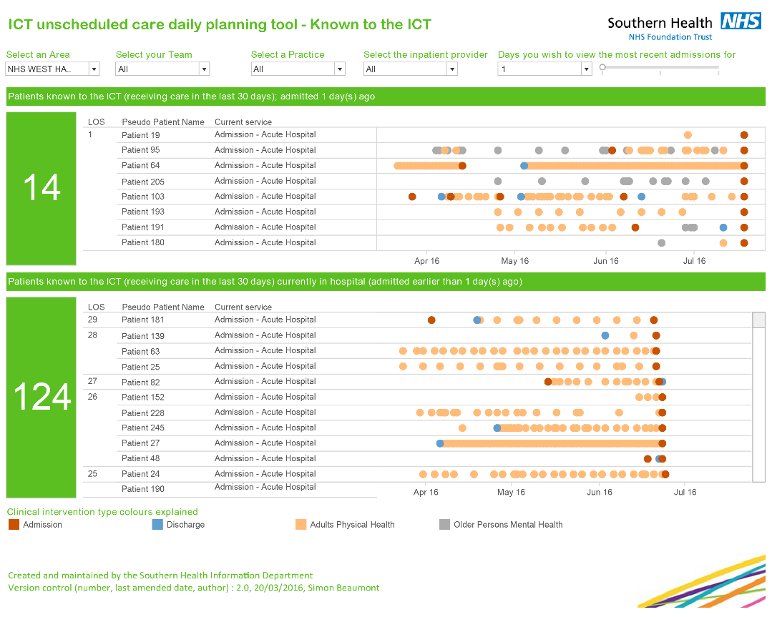
Source: The Big Book of Dashboards (BigBookofDashboards.com)
Notes:
This dashboard was created by Simon Beaumont and is used as a planning tool for unscheduled care at Southern Health. The dot plot uses 4 colors outlines in the legend at the bottom. An entire 3 month period is shown for each patient in the display. The patterns are easily identified, for example Patient 27 versus patient 152.

Slide 28
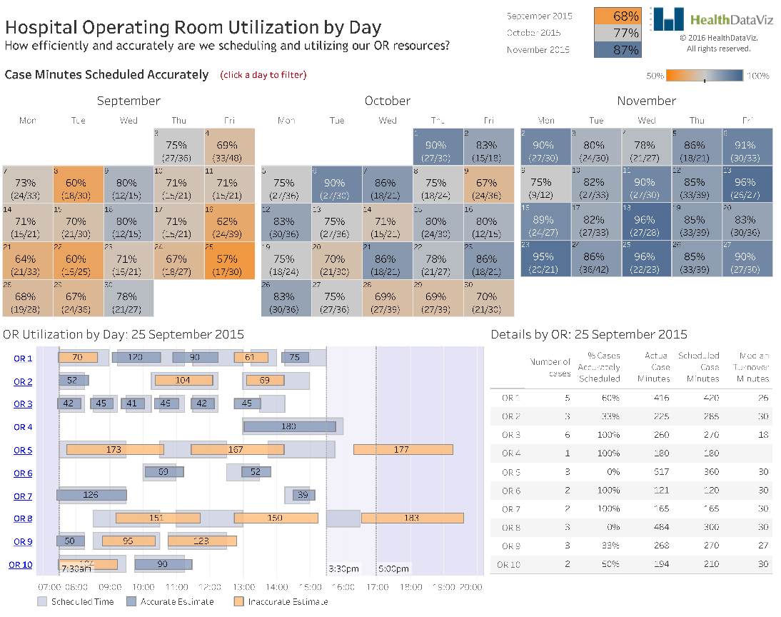
Source: The Big Book of Dashboards (BigBookofDashboards.com)
Notes:
This Hospital Operating Room Utilization Dashboard is packed with information. There is a 3 month calendar view at the top of the dashboard showing the utilization for each day. The calendar is used to filter the rest of the dashboard. Once a day is selected, each operating room is shown, which is then colored with 3 colors. Gray shows the scheduled time as a larger bar, with the narrower bars in blue for accurate scheduling and orange for inaccurate scheduling.

Slide 29
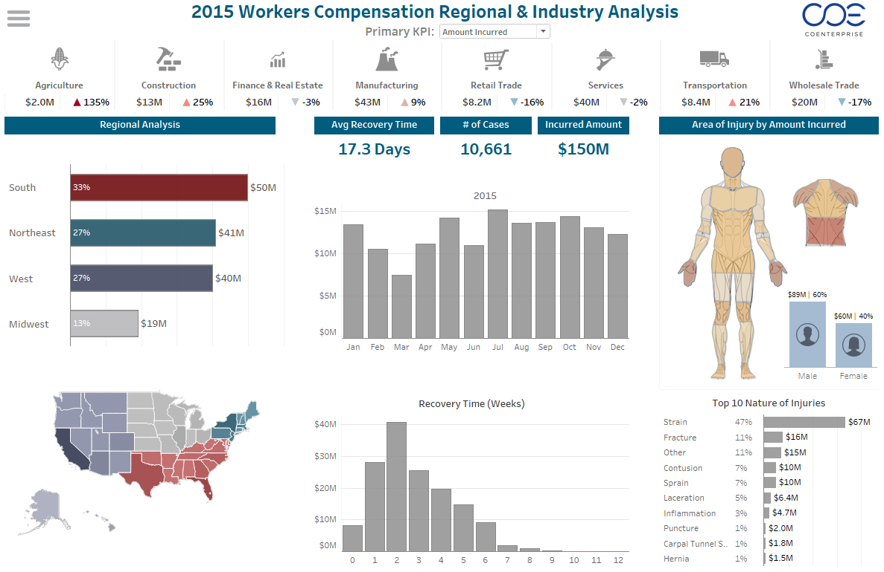
Source: The Big Book of Dashboards (BigBookofDashboards.com)
Notes:
CoEnterprises designed this Worker’s Compensation Dashboard that is loaded with information and interactive features. Color is used to show regions of the country. Nearly everything on this dashboard is interactive. Clicking the icons at the top, the bar chart or even a body part on the human figure will act as a filter for this dashboard. This makes the analysis rich, as the user can explore various aspects of Worker Compensation claims.

Slide 30
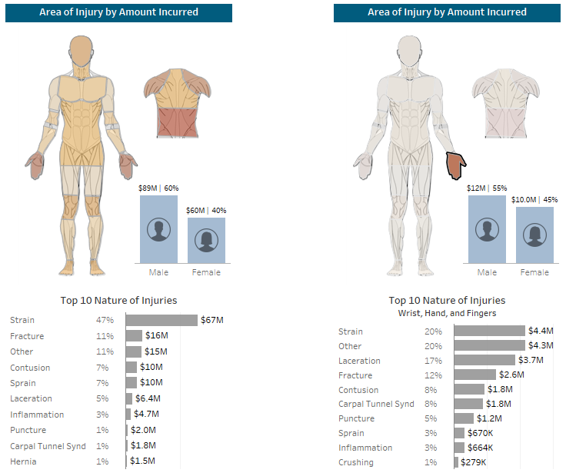
Source: The Big Book of Dashboards (BigBookofDashboards.com)
Notes:
On the left is the view of the entire body. On the right it is filteres to Wrist, Hand and Finger injuries. That bar chart for the nature of the injury and the Male/Female then filters based on the body part selection. We will explore this more in the Interactive Visualization section.

